Slide 1
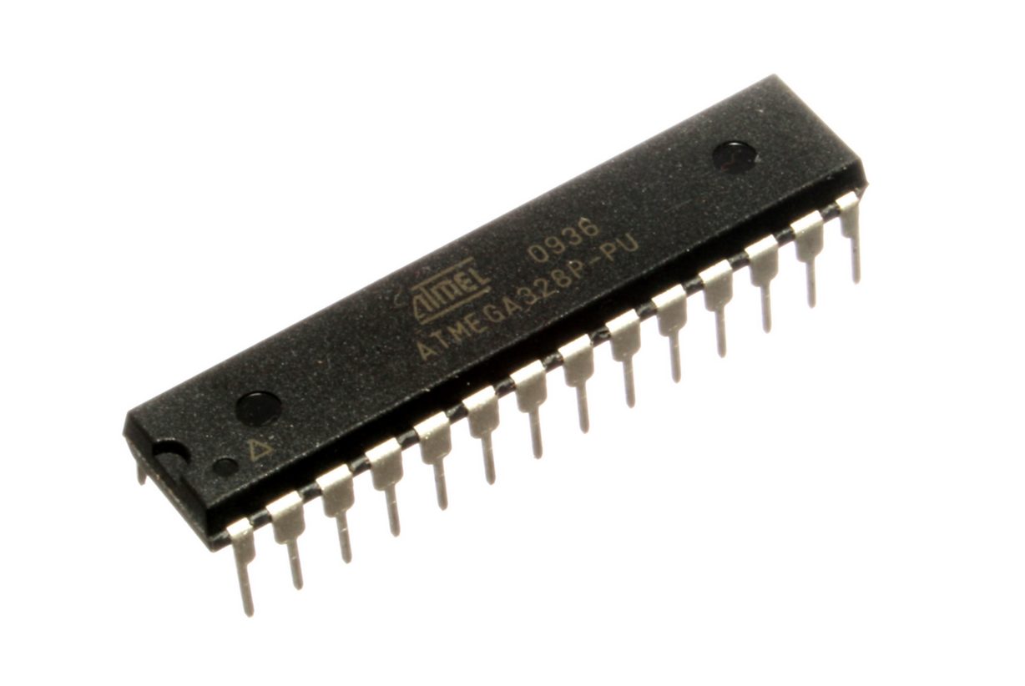
CS341 Lab 2

Slide 2
Some Housekeeping:
https://github.com/whittyh/CS341
the lab is often going to be posted on github slightly before it reaches the class website and extra content will only be posted there
Be sure to sign in on the attendance form! 4 people weren’t signed in last week.
There are 2 make up lab sessions at the end of the semester. Additionally if you know you are going to miss a session for any reason, I suggest planning to attend a different lab that week to avoid needing to do a makeup at the end of the semester. Email me ahead of time if possible in this case.
Updated more thorough lab writeup template is on github

Slide 3
Submission Poll: How do you prefer to turn in labs and receive grades?
https://forms.gle/RK95C3vfqm1y7QVP6
Entirely in unix accounts:
  Create a folder called ‘lab’ in your cs341 directory and name your submissions ‘labx’ where x is the lab #. (i.e lab1, lab2, etc)
  Grades will be placed in the lab folder and titled ‘labxgrade’
Paper:
  Hand in printed labs at start of next session, grades will be returned at the same time in hard copies.
Email:
  Email me your labs before the start of next session and receive an emailed grade in return

Slide 4
Memory Management Architecture:
Harvard:
Memory in three distinct index-able spaces
  Program – compiled code
  Data – variables
  Configuration – settings, long term storage
used by Arduino
Von Neuman:
All memory in one index-able space
  Text stores compiled instructions
  Data section stores global variables
  Stack stores local variables and function arguments
  Heap stores dynamically allocated variables (malloc)
More widely used

Slide 5
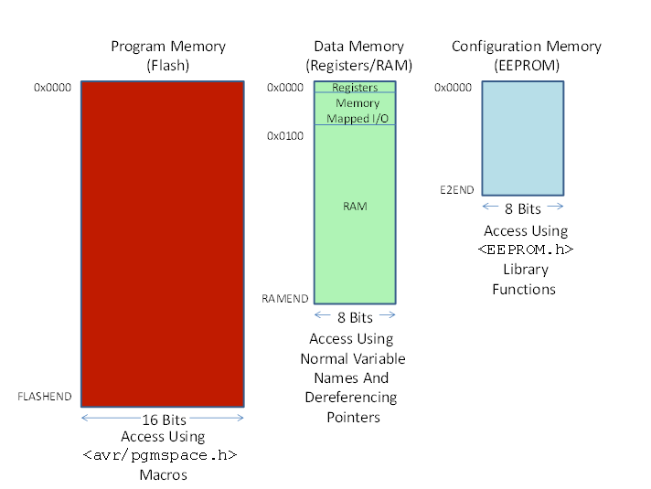
HARVARD ARCHITECTURE:

Slide 6
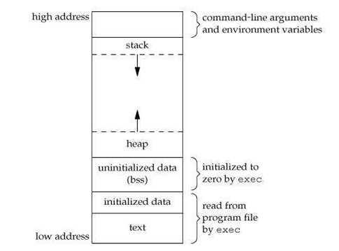
Von Neumann Architecture
https://www.hackerearth.com/practice/notes/memory-layout-of-c-program/

Slide 7
Introduction to Lab 2
  PART 1:
    Figure out the size of the memory spaces:
      FLASH, RAM, and EEPROM
      Un-comment part 1 and record the serial monitor constants outputted
  PART 2:
    The heap, stack, and initialized data are all stored between 0x100 and RAMEND
    Un-comment part 2 and study the serial output as well as the setup to understand what values are stored where.
    How is it divided up?
  PART 3:
    Use the functions displayRAM and displayAllRAM to print out each section of ram to confirm (or contrast) your analysis of part 2
  PART 4: (optional/ 2 points extra credit on lab report)
    Re-comment part 3 and un-comment part 4

Slide 8
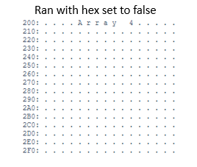
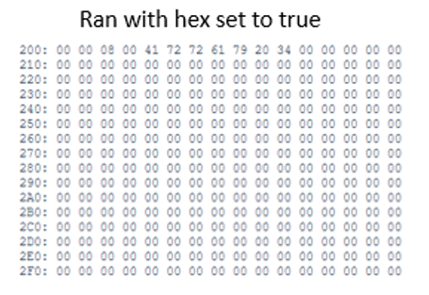
Sample Output:
The integer 4 is found at memory address 0x20A

Slide 9
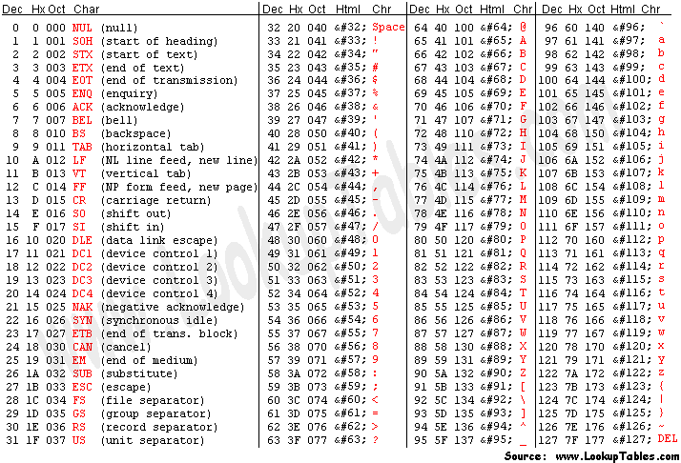
ASCII Table for reference:

